Slide 1
Introduction to Reinforcement Learning

Slide 2
Outline
Real life example of Reinforcement Learning
Terminologies

Slide 3
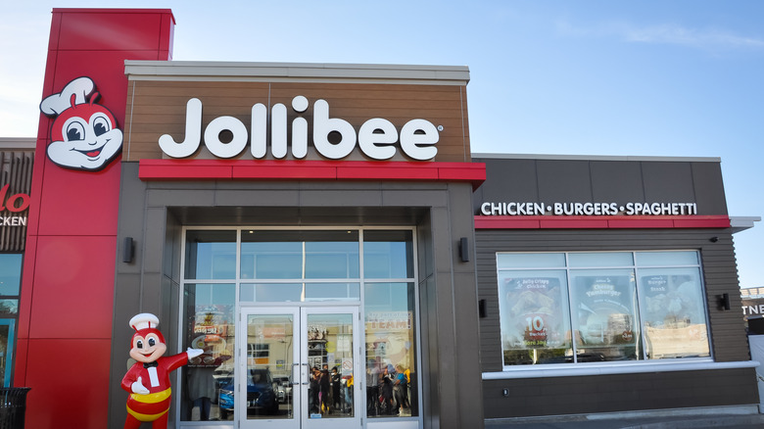
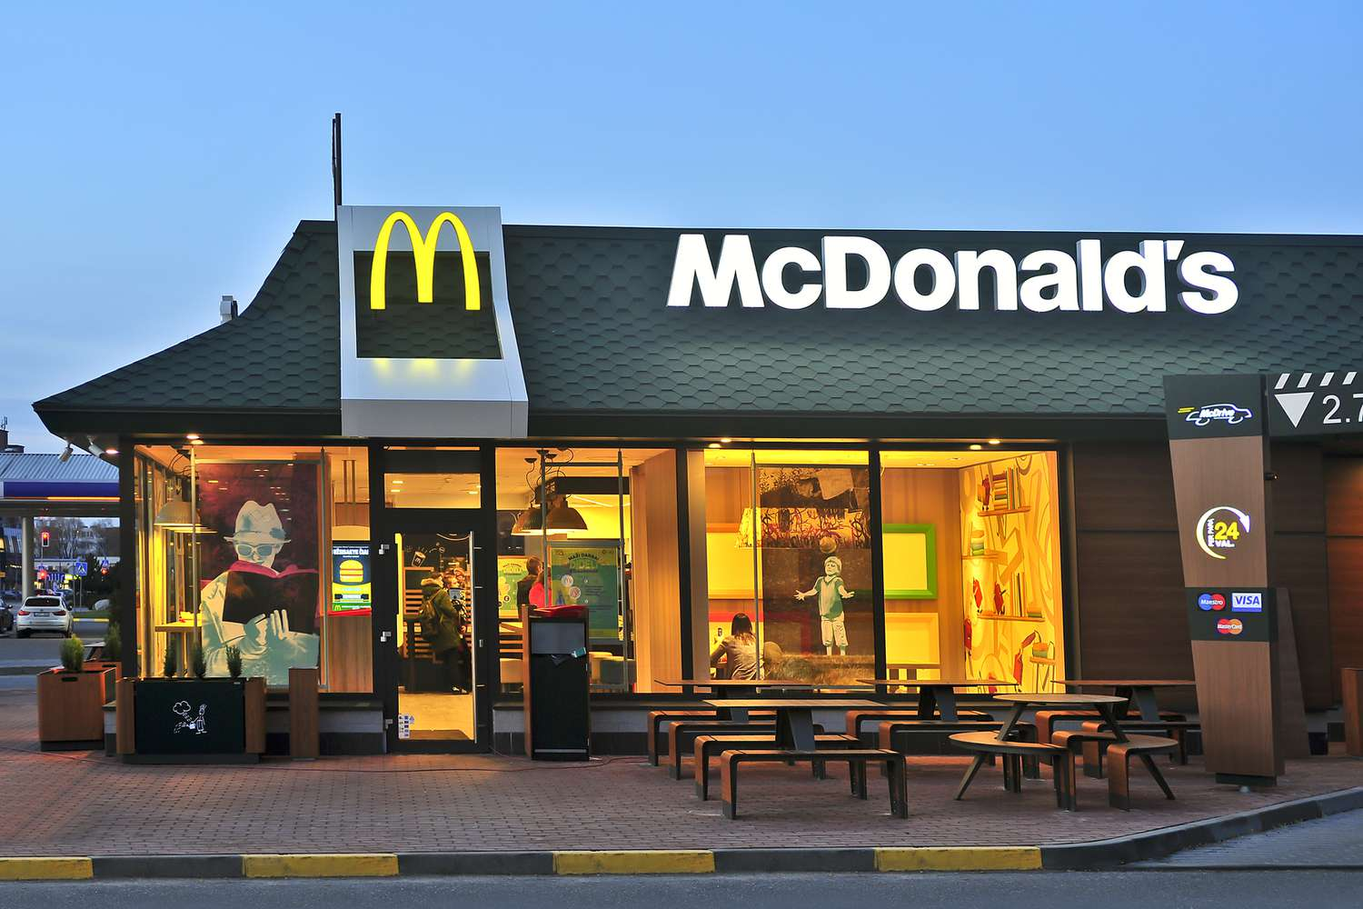
Imagine we were hungry and we wanted to each a delicious fried chicken and had
to choose between going to
and

Slide 4
The problem is that we have never been to either place, so how do we decide where to go to?

Slide 5
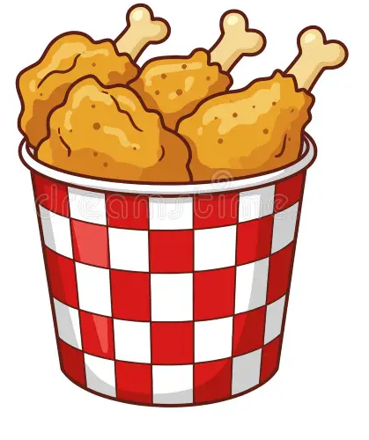
Specifically, we would like to know which place will do a better job of giving us a satisfying order of fried chicken

Slide 6
To solve this problem, we are going to use Reinforcement learning

Slide 7
Reinforcement learning is a methodology that basically lets computers Learn and Adapt based on Experience

Slide 8
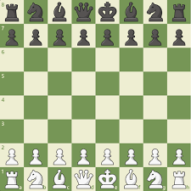
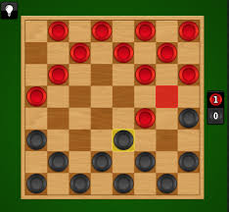
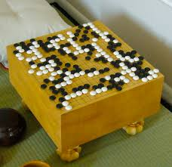
For example, Reinforcement learning has been used to help computers become better at playing games like Chess, Checkers and Go.

Slide 9
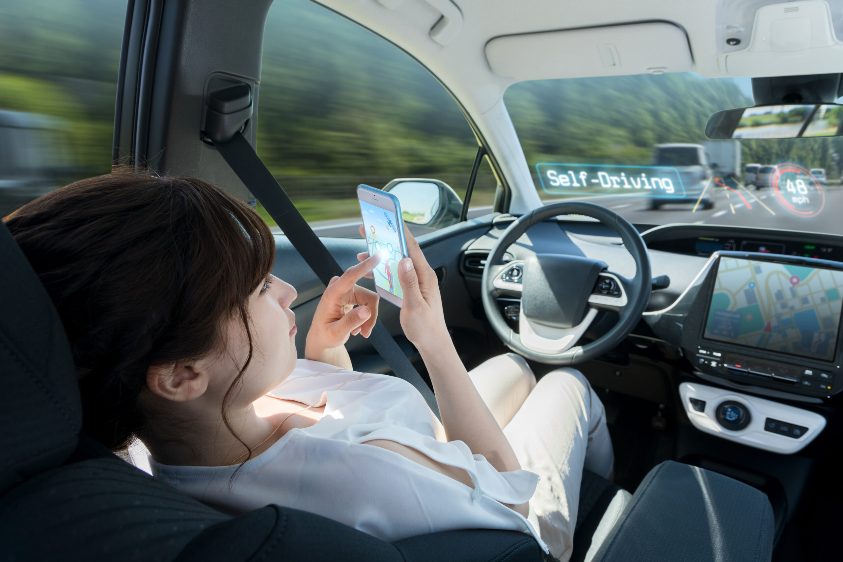
And to help cars drive by themselves

Slide 10

And it’s even been used Large Language Models like ChatGPT to make it sound more human when it responds to your prompts.

Slide 11
That said, in this example, we are going to learn how can it help us decide where to each fried chicken.

Slide 12
Note: What follows is just one example of how Reinforcement Learning can be done and the purpose is to focus on the Main Ideas of how this method works.

Slide 13
For now, we are going to ignore the terminologies associated with Reinforcement Learning. We will dive into the terminology later.

Slide 14
With that said, let us see how Reinforcement Learning can help us decide where we should go eat fries.

Slide 15
Since we have never been to either restaurant, we will start with each place having an equal probability that we will go there.

Slide 16
In other words, we will start with the probability of picking Jollibee for a delicious fried chicken, p(jollibee), set to 0.5
p(jollibee) = 0.5

Slide 17
And the probability of picking Mcdonalds for a tasty fried chicken, p(mcdo), set to 0.5
p(jollibee) = 0.5
p(mcdo) = 0.5

Slide 18
To visualize how we will choose a restaurant, let us draw a line 0.5 units long to represent the probability of going to Jollibee..
0
Go to Jollibee
0.5
1
p(jollibee) = 0.5
p(mcdo) = 0.5

Slide 19
And another 0.5 units to represent the probability of going to Mcdo..
0
Go to Jollibee
0.5
Go to
Mcdo
1
p(jollibee) = 0.5
p(mcdo) = 0.5

Slide 20
Combined, we have a line that goes from 0 to 1
0
Go to Jollibee
0.5
Go to
Mcdo
1
p(jollibee) = 0.5
p(mcdo) = 0.5

Slide 21
Now, to decide which restaurant to visit, we pick a random number between 0 and 1
0
Go to Jollibee
0.5
Go to
Mcdo
1
p(jollibee) = 0.5
p(mcdo) = 0.5

Slide 22
In this example, we randomly pick the number 0.7
0
Go to Jollibee
0.5
Go to
Mcdo
1
p(jollibee) = 0.5
p(mcdo) = 0.5

Slide 23
And because 0.7 is in the region that represents mcdo, we go there.
0
Go to Jollibee
0.5
Go to
Mcdo
1
p(jollibee) = 0.5
p(mcdo) = 0.5

Slide 24
And when we go to mcdo, we are served a large order of well-cooked fried chicken.
0
Go to Jollibee
0.5
Go to
Mcdo
1
p(jollibee) = 0.5
p(mcdo) = 0.5

Slide 25
Getting served a satisfying order of fried chicken at mcdo is great, but so far, we have only been there once.
0
Go to Jollibee
0.5
Go to
Mcdo
1
p(jollibee) = 0.5
p(mcdo) = 0.5

Slide 26
That means we do not have a lot of confidence that most of the time, we will be served a satisfying order of fried chicken at mcdo.
0
Go to Jollibee
0.5
Go to
Mcdo
1
p(jollibee) = 0.5
p(mcdo) = 0.5

Slide 27
And it is possible that Jollibee also serves satisfying order of fried chicken, so we still might want to try out Jollibee.
0
Go to Jollibee
0.5
Go to
Mcdo
1
p(jollibee) = 0.5
p(mcdo) = 0.5

Slide 28
Because it is our first time to eat at mcdo and we were served a satisfying order of fried chicken, we are not sure if that will happen most of the time
p(jollibee) = 0.5
p(mcdo) = 0.5

Slide 29
It makes sense that we should increase the probability that we will visit mcdo in the future, but just by a little bit.
p(jollibee) = 0.5
p(mcdo) = 0.5

Slide 30
It makes sense that we should increase the probability that we will visit mcdo in the future, but just by a little bit.
p(jollibee) = 0.5
p(mcdo) = 0.5

Slide 31
One way to do that is to assign a score so that we can increase the probability that we will visit mcdo in the future, but just by a little bit.
p(jollibee) = 0.5
p(mcdo) = 0.5

Slide 32
First, because these fried chicken are delicious, on a scale from 0 to 1, we give it a Chicken Score = 1
Chicken score = 1
p(jollibee) = 0.5
p(mcdo) = 0.5

Slide 33
And then we can use this equation to calculate the new probability of visiting mcdo
New p(mcdo) = p(mcdo) +
[Learning Rate * (Chicken Score – p(mcdo))]
Chicken score = 1
p(jollibee) = 0.5
p(mcdo) = 0.5

Slide 34
This equation uses the existing probability that we will visit mcdo, p(mcdo)
New p(mcdo) = p(mcdo) +
[Learning Rate * (Chicken Score – p(mcdo))]
Chicken score = 1
p(jollibee) = 0.5
p(mcdo) = 0.5

Slide 35
And combines it with the Chicken Score that we assigned to our order of fries..
New p(mcdo) = p(mcdo) +
[Learning Rate * (Chicken Score – p(mcdo))]
Chicken score = 1
p(jollibee) = 0.5
p(mcdo) = 0.5

Slide 36
And a Learning Rate which helps prevent changing the probability too much too soon
New p(mcdo) = p(mcdo) +
[Learning Rate * (Chicken Score – p(mcdo))]
Chicken score = 1
p(jollibee) = 0.5
p(mcdo) = 0.5

Slide 37
Let us plug in the values to calculate the new probability of visiting mcdo, New p(mcdo)
New p(mcdo) = p(mcdo) +
[Learning Rate * (Chicken Score – p(mcdo))]
Chicken score = 1
p(jollibee) = 0.5
p(mcdo) = 0.5

Slide 38
We plug in the current value for p(mcdo) which is 0.5
New p(mcdo) = 0.5 +
[Learning Rate * (Chicken Score – 0.5)]
Chicken score = 1
p(jollibee) = 0.5
p(mcdo) = 0.5

Slide 39
We plug in the Chicken score, 1
New p(mcdo) = 0.5 +
[Learning Rate * (1 – 0.5)]
Chicken score = 1
p(jollibee) = 0.5
p(mcdo) = 0.5

Slide 40
And we plug in the Learning Rate, which in this example, we will set to 0.1
New p(mcdo) = 0.5 +
[0.1 * (1 – 0.5)]
Chicken score = 1
p(jollibee) = 0.5
p(mcdo) = 0.5

Slide 41
When we do the math, we get 0.55
New p(mcdo) = 0.5 + 0.05 = 0.55
Chicken score = 1
p(jollibee) = 0.5
p(mcdo) = 0.5

Slide 42
That means, we increase the probability of going to mcdo, to 0.55
New p(mcdo) = 0.5 + 0.05 = 0.55
Chicken score = 1
p(jollibee) = 0.5
p(mcdo) = 0.5

Slide 43
And when we calculate the new probability of visiting Jollibee, new p(jollibee)
New p(jollibee) = 1 – new p(mcdo)
Chicken score = 1
p(jollibee) = 0.5
p(mcdo) = 0.5

Slide 44
That means we decrease the probability of gong to Jollibee to 0.45
New p(jollibee) = 1 – new p(mcdo)
= 1 – 0.55
= 0.45
Chicken score = 1
p(jollibee) = 0.5
p(mcdo) = 0.5

Slide 45
That means we decrease the probability of gong to Jollibee to 0.45
New p(jollibee) = 1 – new p(mcdo)
= 1 – 0.55
= 0.45
Chicken score = 1
p(jollibee) = 0.5
p(mcdo) = 0.5

Slide 46
In other words, we increased the probability that we will visit mcdo in the future by a little bit and decrease the probability of visiting Jollibee by a little bit,
Chicken score = 1
p(jollibee) = 0.45
p(mcdo) = 0.55

Slide 47
Increasing the probability if visiting mcdo the next time we want a fried chicken makes sense because even though we got a satisfying order of chicken at mcdo, so far we have only been there once.
Chicken score = 1
p(jollibee) = 0.45
p(mcdo) = 0.55

Slide 48
And its possible that mcdo’s fried chicken will always taste great and its also possible that Jollibee’s chicken could be delicious, so we still want to have a chance to visit Jollibee.
Chicken score = 1
p(jollibee) = 0.5
p(mcdo) = 0.5

Slide 49
Before we move on and visit another restaurant, lets reset each probability again to 0.5 and talk about the Learning Rate
Chicken score = 1
p(jollibee) = 0.5
p(mcdo) = 0.5

Slide 50
Learning Rates control how big or small a change we will make to the probabilities each time we update them.
Chicken score = 1
p(jollibee) = 0.5
p(mcdo) = 0.5

Slide 51
For this equation, Learning Rates are set to values between 0 and 1
New p(mcdo) = p(mcdo) +
[Learning Rate * (Chicken Score – p(mcdo))]
Chicken score = 1
p(jollibee) = 0.5
p(mcdo) = 0.5

Slide 52
If we set the Learning Rate to 0
New p(mcdo) = p(mcdo) +
[0 * (Chicken Score – p(mcdo))]
Poof
Chicken score = 1
p(jollibee) = 0.5
p(mcdo) = 0.5

Slide 53
Then the whole second term goes away
New p(mcdo) = p(mcdo)
Chicken score = 1
p(jollibee) = 0.5
p(mcdo) = 0.5

Slide 54
And we end up with..
New p(mcdo) = p(mcdo)
Chicken score = 1
p(jollibee) = 0.5
p(mcdo) = 0.5

Slide 55
In other words, when the Learning Rate is 0, we don’t make any changes at all
New p(mcdo) = p(mcdo)
Chicken score = 1
p(jollibee) = 0.5
p(mcdo) = 0.5

Slide 56
In contrast, if we set the Learning Rate to 1.
New p(mcdo) = p(mcdo) +
[1 * (Chicken Score – p(mcdo))]
Chicken score = 1
p(jollibee) = 0.5
p(mcdo) = 0.5

Slide 57
And plug in the Chicken score and current probability..
New p(mcdo) = 0.5 +
[1 * (1 – 0.5))]
Chicken score = 1
p(jollibee) = 0.5
p(mcdo) = 0.5

Slide 58
Then we end up setting new p(mcdo) to 1.
New p(mcdo) = 0.5 + 0.5 = 1
Chicken score = 1
p(jollibee) = 0.5
p(mcdo) = 0.5

Slide 59
That means that the next time we want fried chicken, we will go to mcdo without leaving any to probability to visit jollibee
New p(mcdo) = 0.5 + 0.5 = 1
Chicken score = 1
p(jollibee) = 0.5
p(mcdo) = 0.5

Slide 60
And that is not something we want to do because we have never been to Jollibee.
New p(mcdo) = 0.5 + 0.5 = 1
Chicken score = 1
p(jollibee) = 0.5
p(mcdo) = 0.5

Slide 61
When we set the Learning Rate to something larger than 0 and less than 1 like we did before..
New p(mcdo) = p(mcdo) +
[Learning Rate * (Chicken Score – p(mcdo))]
Chicken score = 1
p(jollibee) = 0.5
p(mcdo) = 0.5

Slide 62
We end up setting new p(mcdo) to 0.55 which is just a little larger than the original value for p(mcdo), 0.5
New p(mcdo) = 0.5 + 0.05 = 0.55
Chicken score = 1
p(jollibee) = 0.5
p(mcdo) = 0.5

Slide 63
That small change does a better job reflecting the tasty fried chicken we got from mcdo while also preserving the change we will visit Jollibee.
New p(mcdo) = 0.5 + 0.05 = 0.55
Chicken score = 1
p(jollibee) = 0.5
p(mcdo) = 0.5

Slide 64
Let go back to our example and get another fried chicken because we are hungry!
Chicken score = 1
p(jollibee) = 0.45
p(mcdo) = 0.55

Slide 65
Like before, we draw a line but this time the line for Jollibee is a little shorter and the line for mcdo is a little longer
Chicken score = 1
0
Go to Jollibee
0.45
Go to
Mcdo
1
p(jollibee) = 0.45
p(mcdo) = 0.55

Slide 66
Next, we pick another random number between 0 and 1
Chicken score = 1
0
Go to Jollibee
0.45
Go to
Mcdo
1
p(jollibee) = 0.45
p(mcdo) = 0.55

Slide 67
Next, we pick another random number between 0 and 1 and this time we get 0.2
Chicken score = 1
0
Go to Jollibee
0.45
Go to
Mcdo
1
p(jollibee) = 0.45
p(mcdo) = 0.55

Slide 68
Because 0.2 is in the region that represents Jollibee, we go there.
Chicken score = 1
0
Go to Jollibee
0.45
Go to
Mcdo
1
p(jollibee) = 0.45
p(mcdo) = 0.55

Slide 69
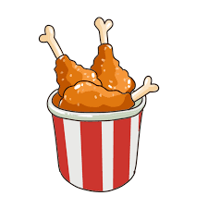
And when we go to Jollibee, we get served an unsatisfying small order of fried chicken
p(jollibee) = 0.45
p(mcdo) = 0.55

Slide 70
Because Jollibee’s fried chicken are unsatisfying, we give them a Chicken score of 0
Chicken score = 0
p(jollibee) = 0.45
p(mcdo) = 0.55

Slide 71
Now, we can use this equation to calculate the new probability for visiting Jollibee, new p(jollibee)
New p(jollibee) = p(jollibee) +
[Learning Rate * (Chicken Score – p(jollibee))]
Chicken score = 0
p(jollibee) = 0.45
p(mcdo) = 0.55

Slide 72
So we plug in the numbers using the same Learning Rate, 0.1
New p(jollibee) = 0.45 +
[0.1 * (0 – 0.45)]
Chicken score = 0
p(jollibee) = 0.45
p(mcdo) = 0.55

Slide 73
Because the fried chicken at Jollibee were unsatisfying, we reduce the probability we will go there from 0.45 to 0.41
New p(jollibee) = 0.45 -0.045 = 0.41
Chicken score = 0
p(jollibee) = 0.45
p(mcdo) = 0.55

Slide 74
With the new probability for visiting Jollibee, we can update our probability for visiting mcdo
New p(mcdo) = 1 – new p(jollibee)
Chicken score = 0
p(jollibee) = 0.41
p(mcdo) = 0.55

Slide 75
And we increase the probability that we will visit mcdo from 0.55 to 0.59
New p(mcdo) = 1 – 0.41 = 0.59
Chicken score = 0
p(jollibee) = 0.41
p(mcdo) = 0.59

Slide 76
Now, when we draw out the probabilities, the line for Jollibee will be shorted and the line for mcdo will be longer
Chicken score = 0
Go to Jollibee
Go to
Mcdo
0
0.41
1
p(jollibee) = 0.41
p(mcdo) = 0.59

Slide 77
We pick another random number and this time we get 0.1 so we go back to Jollibee.
0
Go to Jollibee
0.41
Go to
Mcdo
1
p(jollibee) = 0.41
p(mcdo) = 0.59

Slide 78
And again, when we go back, the fried chicken are still lame so we give a Chicken score of 0
Chicken score = 0
p(jollibee) = 0.41
p(mcdo) = 0.59

Slide 79
And we use that to update the probability we will visit Jollibee in the future to 0.37
New p(jollibee) = 0.41 +
[0.1 * (0 – 0.41)] = 0.37
Chicken score = 0
p(jollibee) = 0.37
p(mcdo) = 0.59

Slide 80
Then we update the probability that we will visit mcdo in the future to 0.63
New p(mcdo) = 1 – new p(mcdo)
= 1- 0.37
= 0.63
Chicken score = 0
p(jollibee) = 0.37
p(mcdo) = 0.63

Slide 81
Using this approach , we can continue to visit Jollibee and mcdo to update the probabilities we will go to each place
p(jollibee) = 0.37
p(mcdo) = 0.63

Slide 82
After repeating those steps a bunch of times, the probability of going to Jollibee ends up at 0.19
p(jollibee) = 0.19
p(mcdo) = 0.59

Slide 83
And the probability of going to mcdo ends up at 0.81
p(jollibee) = 0.19
p(mcdo) = 0.81

Slide 84
And now that we know that when we get hungry, most of the time we should go to mcdo.
p(jollibee) = 0.19
p(mcdo) = 0.81

Slide 85
And now that we know that when we get hungry, most of the time we should go to mcdo.
p(jollibee) = 0.19
p(mcdo) = 0.81

Slide 86
Now that we have seen an example of how Reinforcement Learning can work, its time for terminologies.
p(jollibee) = 0.19
p(mcdo) = 0.81

Slide 87
To start, using Reinforcement Learning lingo, we would call Jollibee and Mcdonald’s the Environment
p(jollibee) = 0.19
p(mcdo) = 0.81

Slide 88
The Environment is something we want to explore and can interact with
p(jollibee) = 0.19
p(mcdo) = 0.81

Slide 89
The Environment is something we want to explore and can interact with
In this example, we explore and interact with the Environment by visiting each place and ordering fried chicken
p(jollibee) = 0.19
p(mcdo) = 0.81

Slide 90
And because we are the ones exploring the Environment, we are called the Agent.
p(jollibee) = 0.19
p(mcdo) = 0.81

Slide 91
In this example, we, the Agent, explore the Environment by using the probabilities that we will visit Jollibee and mcdo
p(jollibee) = 0.19
p(mcdo) = 0.81

Slide 92
In this example, we, the Agent, explore the Environment by using the probabilities that we will visit Jollibee and mcdo
And these probabilities are called the Policy.
p(jollibee) = 0.19
p(mcdo) = 0.81

Slide 93
In this example, we use the Policy in a very simple way.
p(jollibee) = 0.19
p(mcdo) = 0.81

Slide 94
We simply pick a random number between 0 and 1
Go to Jollibee
Go to
Mcdo
0
0.19
1
p(jollibee) = 0.19
p(mcdo) = 0.81

Slide 95
And if it lands in an area that represents mcdo, we go to mcdo.
Go to Jollibee
Go to
Mcdo
0
0.19
1
p(jollibee) = 0.19
p(mcdo) = 0.81

Slide 96
Otherwise, if the random number falls in an area that represents jollibee, we go to jollibee.
Go to Jollibee
Go to
Mcdo
0
0.19
1
p(jollibee) = 0.19
p(mcdo) = 0.81

Slide 97
However, our Policy can be more complicated by taking into account how many times we visited Jollibee or Mcdo in the past week or factor how hungry we are
Go to Jollibee
Go to
Mcdo
0
0.19
1
p(jollibee) = 0.19
p(mcdo) = 0.81

Slide 98
Lastly, the Chicken Score, which we used to update the Policy, is called the Reward.
Chicken score = 0
Chicken score = 1
p(jollibee) = 0.19
p(mcdo) = 0.81

Slide 99
In Reinforcement Learning, the goal is to modify the Policy so that we can maximize the Reward
Chicken score = 0
Chicken score = 1
p(jollibee) = 0.19
p(mcdo) = 0.81

Slide 100
And in this example that means updating the probabilities that we visit Jollibee and mcdo so that we maximize the delicious fried chicken we are served
Chicken score = 0
Chicken score = 1
p(jollibee) = 0.19
p(mcdo) = 0.81

Slide 101
Note: In the example given here, most of the time, mcdo gave us a great order of fried chicken and the Reward was relatively high
Chicken score = 0
Chicken score = 1
p(jollibee) = 0.19
p(mcdo) = 0.81

Slide 102
However, every now and then, mcdo may give a small serving and overcooked chicken and the Reward was low
Chicken score = 0
p(jollibee) = 0.19
p(mcdo) = 0.81

Slide 103
So the Reward can change and does not have to always be the same.
Chicken score = 0
p(jollibee) = 0.19
p(mcdo) = 0.81

